Slide 1
Cibercrime Deep Web, Redes Anónimas, Botnets
Seminário
2019
Nuno Santos

Slide 2
Cibercrime
“Todo e qualquer acto ilegal envolvendo um computador, os seus sistemas, ou as suas aplicações” (EC-Council)
EC-Council: International Council of Electronic Commerce Consultants
Refere-se a um conjunto de delitos definidos em leis como:
The U.S. Computer Fraud
The UK Computer Abuse Act
Lei do Cibercrime, in Portugal
Notes:
http://legaldictionary.net/cybercrime/
Criminal activity that entails the use of a computer system, computer technology, or the internet.
Cybercrime is now defined as any criminal offense that is facilitated by, or involves the use of, electronic communications or information systems, including any electronic device, computer, or the internet.

Slide 3
Exemplos de cibercrime
Theft of intellectual property
Identity theft
Identity fraud
Financial fraud
Cyberbullying and cyberstalking
Child pornography
Cyber extortion
Denial of service attacks
Hacker system penetrations
Planting of malicious programs (malware)
Notes:
Any act that would allow an individuals to get access to patents, trade secret, customer data, sales trends and any other confidential information that can be of monetary gain
When fraudsters access enough information about someone’s identity (such as their name, date of birth, addresses) to commit identity fraud
The use of stolen identity in criminal activity to obtain goods or services by deception, e.g.: open bank accounts, obtain credit cards, loans and state benefits, order goods in your name, take over your existing accounts
Any type of criminal behavior that uses fraudulent solicitation to prospective victims to conduct fraudulent transactions
The act of harming or harassing via information technology networks in a repeated and deliberate manner
Victims of cyberbullying are children, victims of cyberstalking are adults
Denial of service attacks
Aim at stopping legitimate requests to a network over the Internet by subjecting the network to illegitimate requests
Hacker system penetrations
A network or system penetration occurs when an outsider gets access to the network and changes settings within the network
Planting of malicious programs (malware)
Virus are attached to applications and cannot replicate themselves alone; can affect machines and seek to affect other vulnerable systems
Worms seek to replicate themselves over the network thereby hogging resources apart from creating malfunctions
Trojan horses and backdoors are programs that allow an intruder to retain access to a compromised machine

Slide 4
Cibercrime in Portugal: Lei do Cibercrime
Lei n.º 109/2009, de 15 de Setembro
http://goo.gl/PTg2oj
CAPÍTULO II: Disposições penais materiais
Artigo 3.º: Falsidade informática
Artigo 4.º: Dano relativo a programas ou outros dados informáticos
Artigo 6.º: Acesso ilegítimo
Artigo 8.º: Reprodução ilegítima de programa protegido
Notes:
http://www.anacom.pt/render.jsp?contentId=985560#.V_Kb-JMrI7x

Slide 5
Evolução do cibercrime
Notes:
https://resources.infosecinstitute.com/evolution-in-the-world-of-cyber-crime/#gref

Slide 6


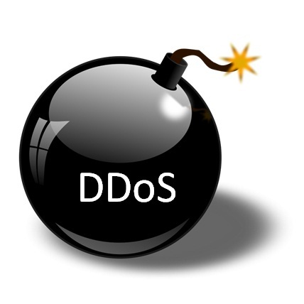

Ferramentas do cibercrime
Deep Web
Como encontrar informação e localizer serviços
Ferramentas do Cibercrime
Sistemas de anonimato
Como esconder a ID na Internet
Botnets
Como lançar ataques em larga escala
Criptomoeda
Como tornar os pagamentos não rastreáveis

Slide 7
The Deep Web

Slide 8




The Web: Powerful tool for cybercriminals
Offender
Provides huge source of information, used in:
Crime premeditation, privacy violations, identity theft, extortion, etc.
Web allows for accessing services for criminal activity
E.g., drug selling, weapon selling, etc.
To find services and info, there are powerful search engines
Google, Bing, Shodan, etc.
Notes:
WWW: an information system on the Internet which allows documents to be connected to other documents by hypertext links, enabling the user to search for information by moving from one document to another.

Slide 9

The Web: powerful also for crime investigation
Investigator
Powerful investigation tool about suspects
Find evidence in blogs, social networks, browsing activity, etc.
The playground where the crime itself is carried out
Illegal transactions, cyber stalking, blackmail, fraud, etc.

Slide 10
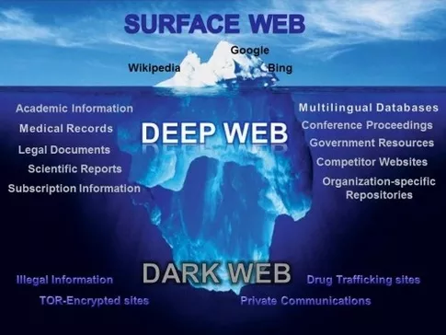
The iceberg analogy
Notes:
What’s “visible” through typical search engines is minimal
Deep Web is not necessarily bad: it’s just that the content is not directly indexed
Part of the deep web where criminal activity is carried out is named the Dark Web

Slide 11

The Surface Web
The Surface Web is that portion of the World Wide Web that is readily available to the general public and searchable with standard web search engines
AKA Visible Web, Clearnet, Indexed Web, Indexable Web or Lightnet
As of June 14, 2015, Google's index of the surface web contains about 14.5 billion pages

Slide 12
How a typical search engine works
Architecture of a typical search engine
Lots and lots of computers
Interface
Query Engine
Users
Index
Crawler
Indexer
Web

Slide 13
Crawling the Web: Start from the seed pages
URLs crawled
and parsed
Unseen Web
Seed
pages
URLs frontier
Web

Slide 14
Google hacking
Google provides keywords for advanced searching
Logic operators in search expressions
Advanced query attributes: “login password filetype:pdf”
To learn more:
http://www.mrjoeyjohnson.com/Google.Hacking.Filters.pdf

Slide 15

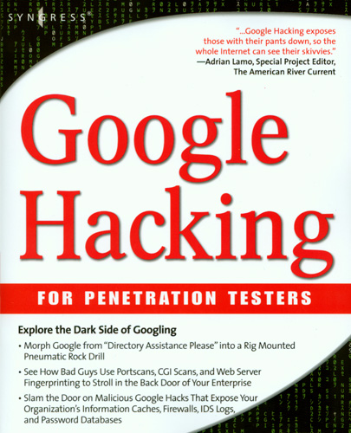
Google hacking: Entire books dedicated to it
Dornfest, Rael, Google Hacks 3rd ed, O’Rielly, (2006)
Ethical Hacking, http://www.nc-net.info/2006conf/Ethical_Hacking_Presentation_October_2006.ppt
A cheat sheet of Google search features: http://www.google.com/intl/en/help/features.html
A Cheat Sheet for Google Search Hacks -- how to find information fast and efficiently http://www.expertsforge.com/Security/hacking-everything-using-google-3.asp
Notes:
https://www.blackhat.com/presentations/bh-europe-05/BH_EU_05-Long.pdf

Slide 16
Google hacking examples: File type searches
filetype: narrow down search results to specific file type
filetype:xls “checking account” “credit card”

Slide 17
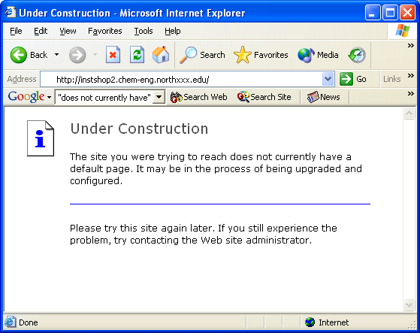
Google hacking examples: Finding servers
intitle:"Under construction" "does not currently have"
intitle:"Welcome to Windows 2000 Internet Services"

Slide 18
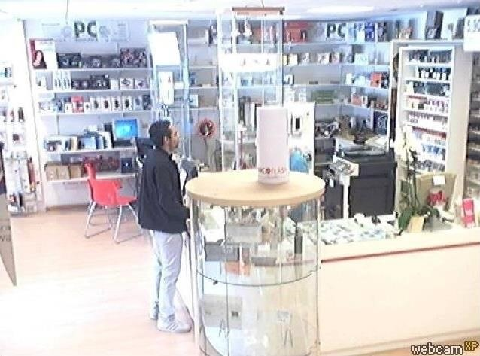
Google hacking examples: Finding webcams
To find open unprotected Internet webcams that broadcast to the web, use the following query:
inurl:/view.shtml
Can also search by manufacturer-specific URL patterns
inurl:ViewerFrame?Mode=
inurl:ViewerFrame?Mode=Refresh
inurl:axis-cgi/jpg
...

Slide 19
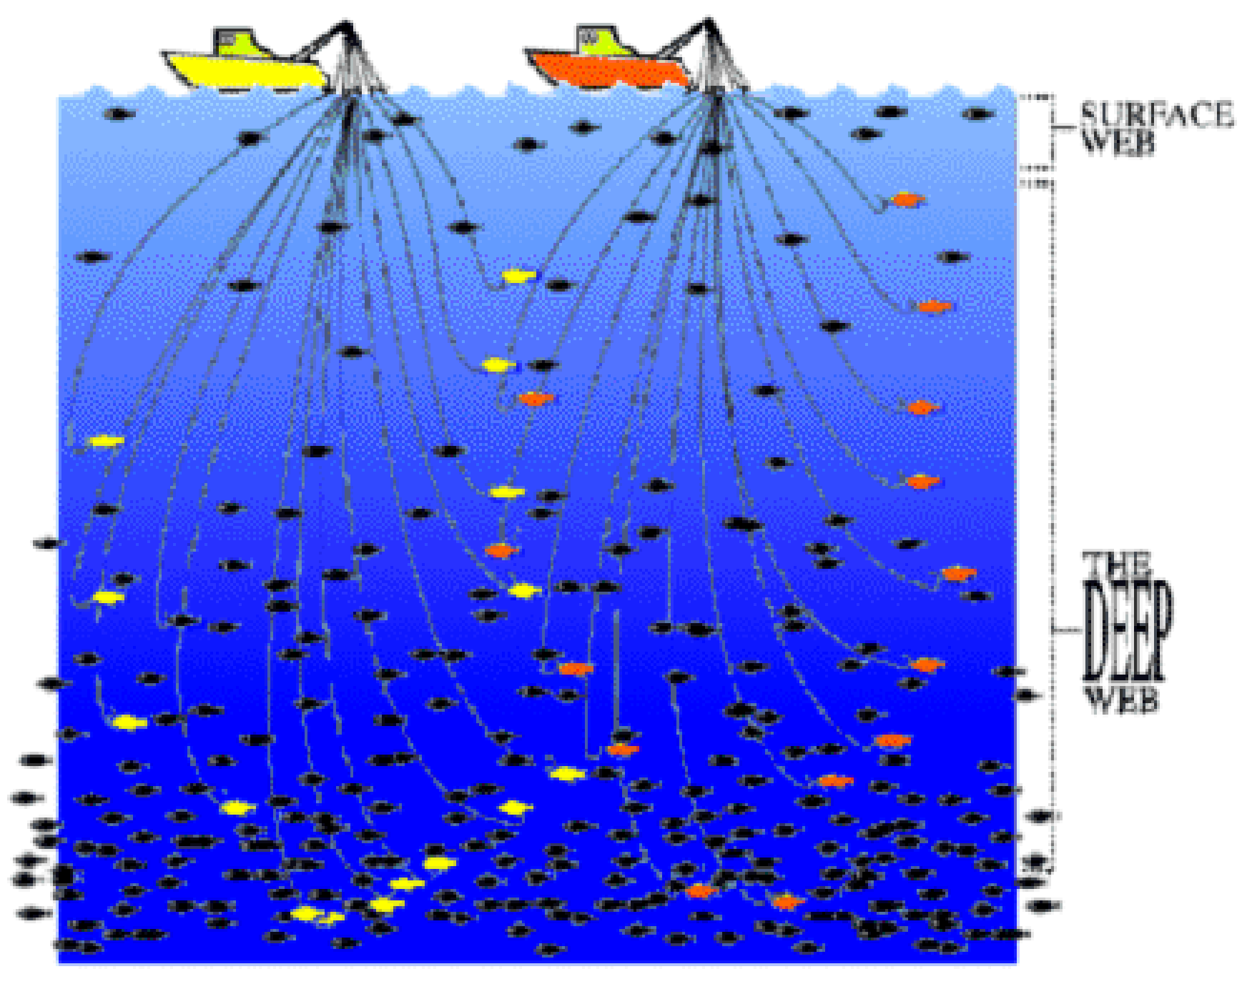
The Deep Web
Deep Web is the part of the Web which is not indexed by conventional search engines and therefore don’t appear in search results
Why is it not indexed by typical search engines?

Slide 20
Some content can’t be found through URL traversal
Dynamic (server generated) web pages and searchable databases
Response to a query or accessed only through a form
Unlinked contents
Pages without any links to them (orphan)
Private web
Sites requiring registration and login
Limited access web
Sites with captchas, no-cache pragma http headers
Notes:
The Pragma: no-cache header field is an HTTP/1.0 header intended for use in requests. It is a means for the browser to tell the server and any intermediate caches that it wants a fresh version of the resource, not for the server to tell the browser not to cache the resource.

Slide 21
In other times, content won’t be found
Crawling restrictions by site owner
Use a robots.txt file to keep files off limits from spiders
Crawling restrictions by the search engine
E.g.: a page may be found this way:
http://www.website.com/cgi-bin/getpage.cgi?name=sitemap
Most search engines will not read past the ? in that URL
Limitations of the crawling engine
E.g., real-time data – changes rapidly – too “fresh”

Slide 22
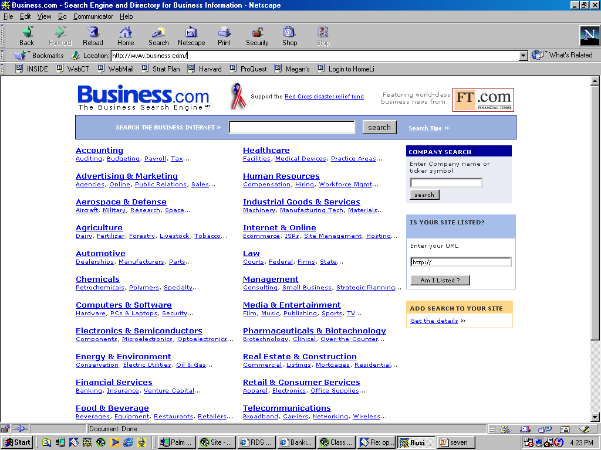
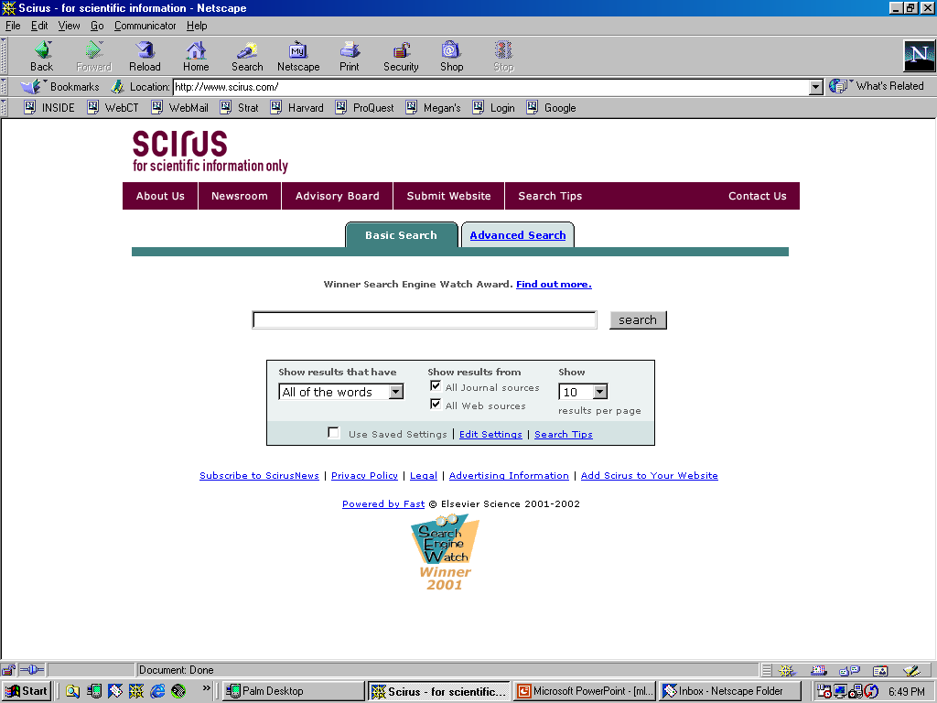
Specialized search engines abound
There’s hundreds of specialized search engines for almost every topic

Slide 23
A particularly interesting search engine
Shodan lets the user find specific types of computers connected to the internet using a variety of filters
Routers, servers, traffic lights, security cameras, home heating systems
Control systems for water parks, gas stations, water plants, power grids, nuclear power plants and particle-accelerating cyclotrons
Why is it interesting?
Many devices use "admin" as user name and "1234" as password, and the only software required to connect them is a web browser

Slide 24
How does Shodan work?
Shodan collects data mostly on HTTP servers (port 80)
But also from FTP (21), SSH (22) Telnet (23), and SNMP (161)
“Google crawls URLs – I don’t do that at all. The only thing I do is randomly pick an IP out of all the IPs that exist, whether it’s online or not being used, and I try to connect to it on different ports. It’s probably not a part of the visible web in the sense that you can’t just use a browser. It’s not something that most people can easily discover, just because it’s not visual in the same way a website is.”
John Matherly, Shodan's creator
Notes:
Simple Network Management Protocol (SNMP) is a popular protocol for network management. It is used for collecting information from, and configuring, network devices, such as servers, printers, hubs, switches, and routers on an Internet Protocol (IP) network.

Slide 25
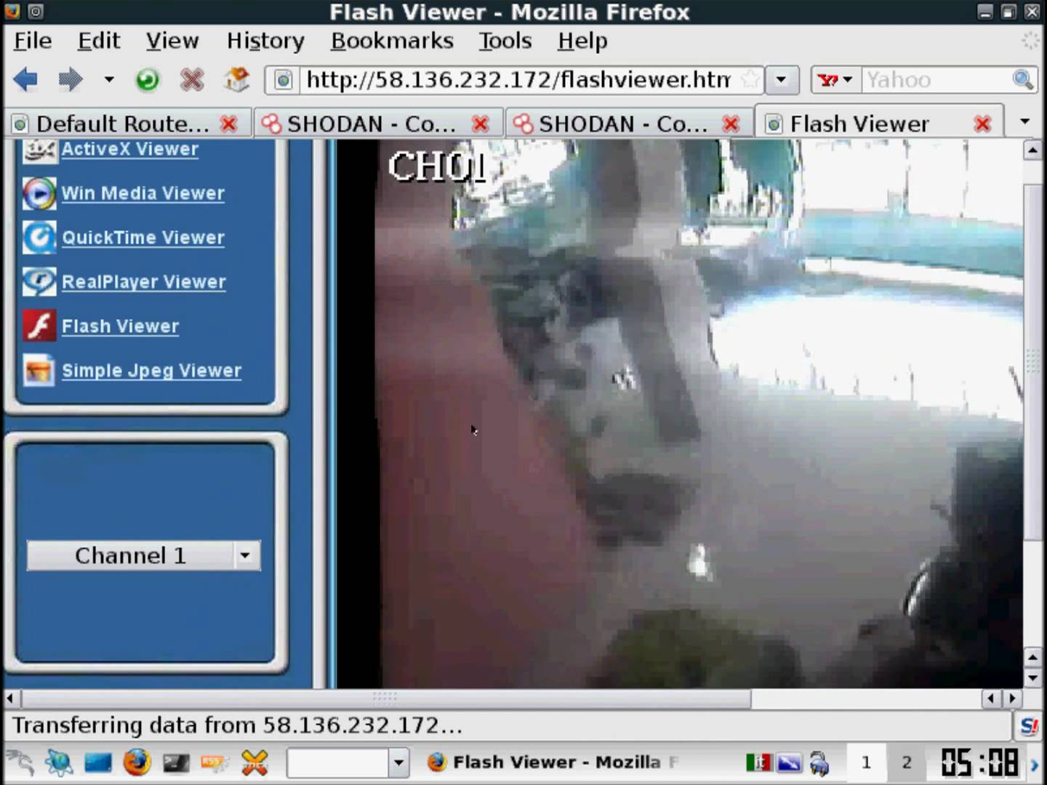
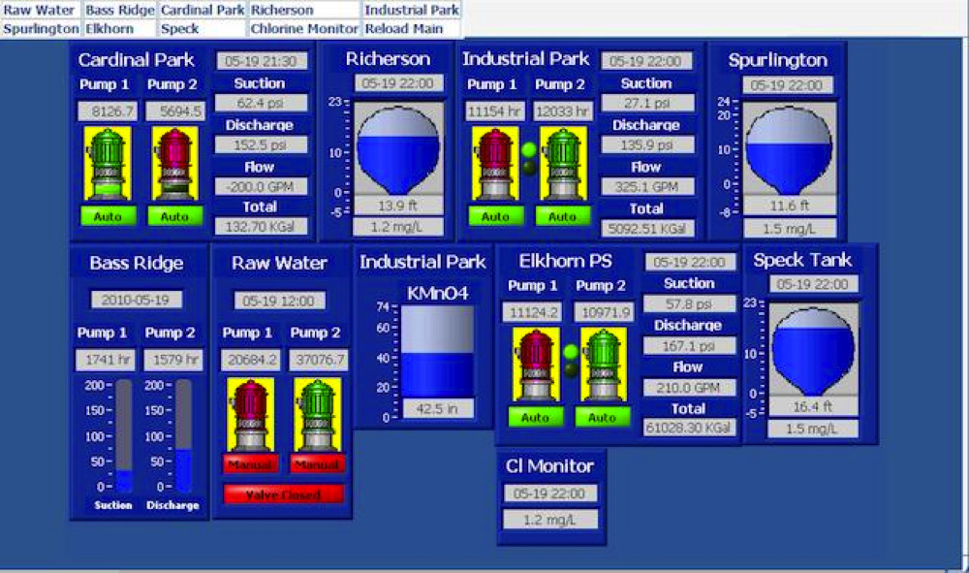
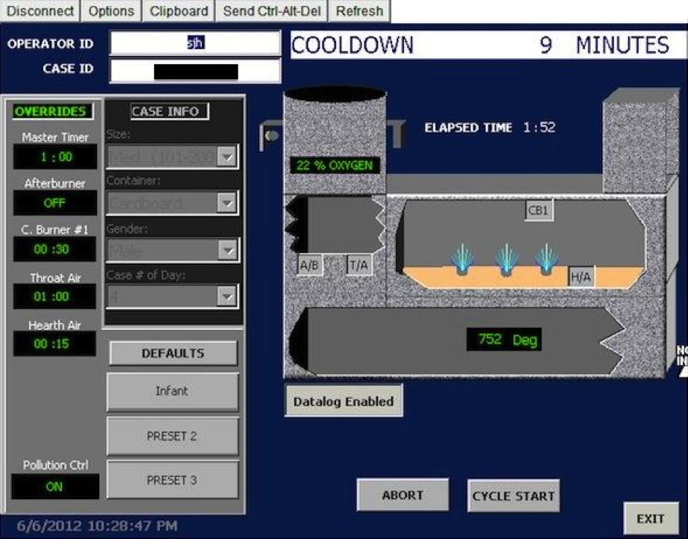
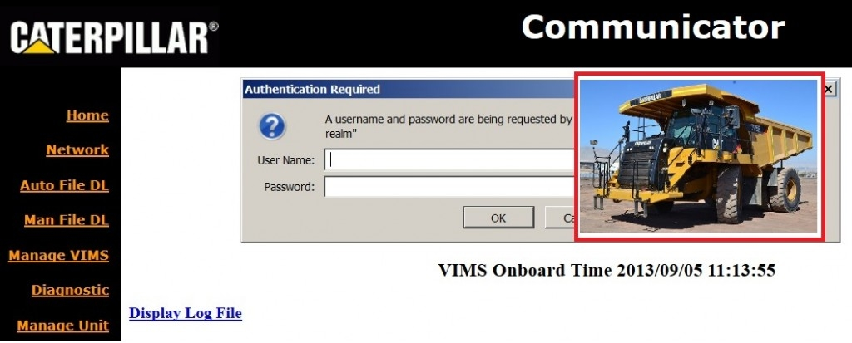
Interesting findings
Webcam
Controls for water treatment facility
Controls of Caterpillar trucks
Controls for a crematorium

Slide 26
Hidden services fuel the Dark Web
Dark Web is the Web content that exists on darknets
Darknets are overlay nets which use the public Internet but require specific SW or authorization to access
Delivered over small peer-to-peer networks
As hidden services on top of Tor

Slide 27
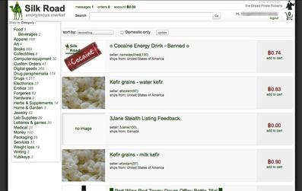
The Dark Web is a haven for criminal activities
Hacking services
Fraud and fraud services
Markets for illegal products
Hitmen
…

Slide 28
Ferramentas do cibercrime
Deep Web
Como encontrar informação e localizer serviços
Ferramentas do Cibercrime
Sistemas de anonimato
Como esconder a ID na Internet
Botnets
Como lançar ataques em larga escala
Criptomoeda
Como tornar os pagamentos não rastreáveis

Slide 29
Anonimato online

Slide 30
Why be anonymous?
If you are a cyber-criminal!
DRM infringement, hacker, spammer, terrorist, etc.
But, also if you are:
Journalist
Whistleblower
Human rights activist
Business executive
Military/intelligence personnel
Abuse victims
Notes:
Definição de comunicação anónima
Hiding the identitie(s) of the parties involved in digital communications from each other, or from third-parties
“Who you are” from the communicating party
“Who you are talking to” from everyone else

Slide 31
Why be anonymous?
How about normal people?
Avoid tracking by advertising companies
Protect sensitive personal information from businesses, like insurance companies, banks, etc.
Express unpopular or controversial opinions
Have a dual life
A professor who is also a pro in World of Warcraft!
Try uncommon things
…
It feels good to have some privacy!
Bottomline: Anonymity is not for criminals only!

Slide 32


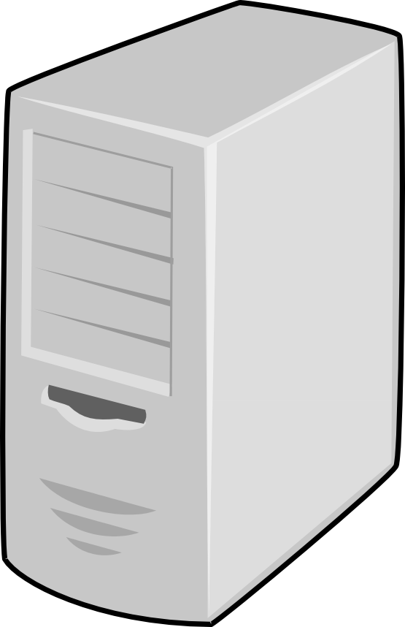

The difficulty to be anonymous: Ex 1 – The IP or the real source is revealed
Spoofer connects to open relay & sends fake email
alice@csf.org
Open Relay
Bob’s MTA
bob@csf.org
From: alice@csf.org
To: bob@csf.org
Alice?
Spoofer

Slide 33
The spoofer’s IP address appears on the email
When sending a spoofed email through an open relay, the true sender’s IP is attached to the email’s header
From jholliday@engr.scu.edu Tue Dec 23 16:44:55 2003
Return-Path: <jholliday@engr.scu.edu>
Received: from server8.engr.scu.edu (root@server8.engr.scu.edu [129.210.16.8])
by server4.engr.scu.edu (8.12.10/8.12.10) with ESMTP id hBO0itpv008140
for <tschwarz@engr.scu.edu>; Tue, 23 Dec 2003 16:44:55 -0800
From: JoAnne Holliday <jholliday@engr.scu.edu>
Received: from 129.210.16.8 (dhcp-19-198.engr.scu.edu [129.210.19.198])
by server8.engr.scu.edu (8.12.10/8.12.10) with SMTP id hBO0W76P002752
for tschwarz; Tue, 23 Dec 2003 16:41:55 -0800 (PST)
Date: Tue, 23 Dec 2003 16:32:07 -0800 (PST)
Message-Id: <200312240041.hBO0W76P002752@server8.engr.scu.edu>
X-Spam-Checker-Version: SpamAssassin 2.60-rc3 (1.202-2003-08-29-exp) on
server4.engr.scu.edu
X-Spam-Level:
X-Spam-Status: No, hits=0.0 required=5.0 tests=none autolearn=ham version=2.60-r
c3
This is a spoofed message.

Slide 34
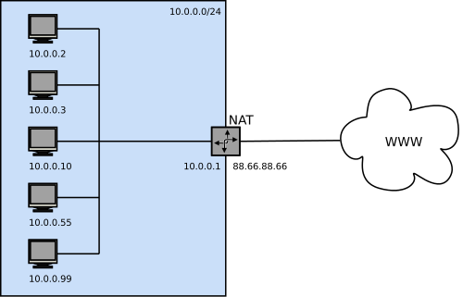
The difficulty to be anonymous: Ex. 2 – The source IP doesn’t need to be revealed
NAT hides multiple clients behind same IP
How to identify them?
If you have access to the NAT, check the mapping table
?

Slide 35
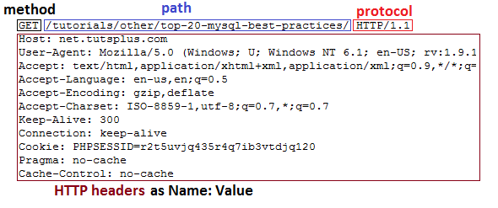
Leverage browser fingerprinting
Systematic collection of browser information from:
HTTP request (user agent and accept headers)
Javascript API (e.g., plugins installed)
Flash plugin API (e.g., OS version, list of fonts, screen resolution, TZ)
HTML5 Canvas element (differences in image rendering)
Notes:
https://amiunique.org/faq
Device fingerprinting or browser fingerprinting is the systematic collection of information about a remote device, for identification purposes. Client-side scripting languages allow the development of procedures to collect very rich fingerprints: browser and operating system type and version, screen resolution, architecture type, lists of fonts, plugins, microphone, camera, etc.
Browser fingerprints are also called “cookieless monsters” because it is not necessary to install any form of cookie to collect a fingerprint. This means that the act of fingerprinting a specific browser is stateless and transparent for the user. Any third-party interested in fingerprinting can exploit a set of different techniques to get a rich fingerprint:
- The user agent and the accept headers are automatically sent to websites when a connection is initiated.
- JavaScript gives access to many browser-populated features like the plugins installed on the user’s device.
- If the Flash plugin is installed, its rich programming interface (API) provides access to many system-specific attributes: exact version of the operating system, list of fonts, screen resolution, timezone.
- Through the display of an HTML5 Canvas element, it is possible to collect small differences in the hardware or in the software configurations, thanks to slight differences in the image rendering between devices. The smallest pixel difference can be detected. This is called canvas fingerprinting.

Slide 36
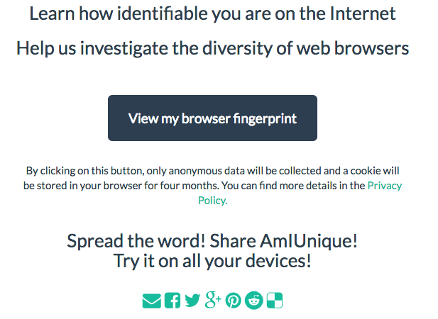
http://amiunique.org

Slide 37
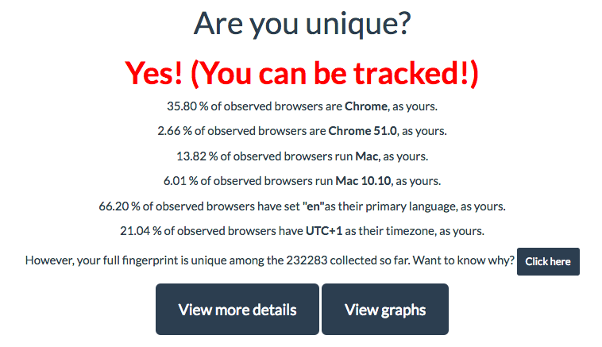
Results on my browser

Slide 38
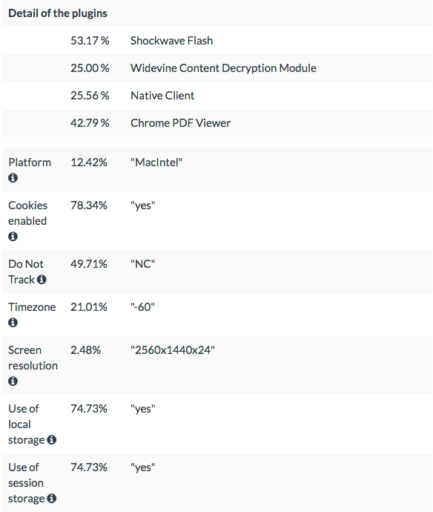
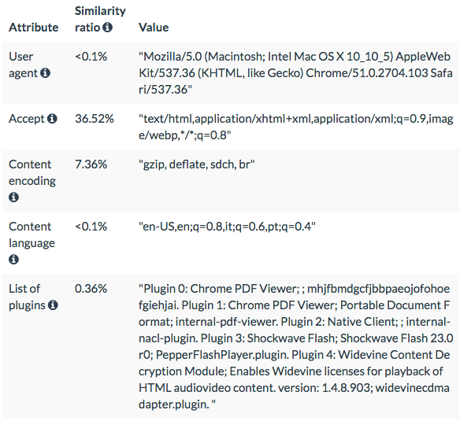
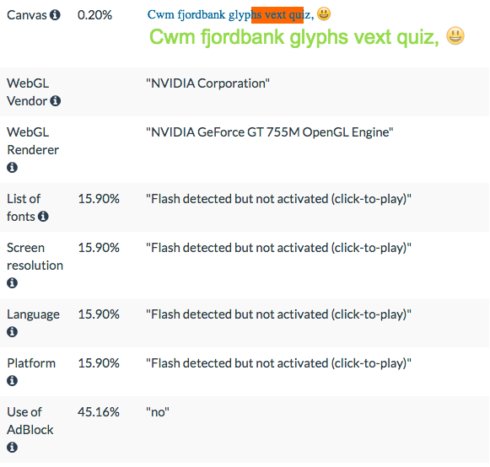
Learning the details

Slide 39
In the Internet, it’s hard to be anonymous
Your IP address can be linked directly to you
ISPs store communications records
Usually for several years (Data Retention Laws)
Law enforcement can subpoena these records
Your browser can be tracked
Cookies, Flash cookies, HTML5 storage
Browser fingerprinting
Your activities can be used to identify you
Unique websites and apps that you use
Types of links that you click

Slide 40


Anonymity systems
Aim to conceal the identity of communicating parties
Anonymity
System
Party B
Party A
?

Slide 41
Types of anonymity
Sender anonymity
Can’t tell who sent this message
Receiver anonymity
Can’t tell who received this message
Sender-receiver anonymity
Can’t tell if A and B are respectively the sender and receiver of this message

Slide 42













Quantifying anonymity
How can we calculate how anonymous we are?
Anonymity Sets
Larger anonymity set = stronger anonymity
Suspects (Anonymity Set)
Who sent this message?

Slide 43

Example where no anonymity exists
Encrypted data traffic (SSL)
Content is unobservable
Due to encryption
Source and destination are trivially linkable
No anonymity!

Slide 44








Basic approach: Anonymizing proxies
HTTPS Proxy
Web proxies are set up to allow forwarding of HTTPS traffic
e.g., https://www.anonymizer.com, http://www.bind2.com/
Notes:
http://security.stackexchange.com/questions/8145/does-https-prevent-man-in-the-middle-attacks-by-proxy-server

Slide 45
Investigating anonymizing proxies
HTTPS Proxy
Destination is known
Source anonymity

Slide 46
Investigating anonymizing proxies
HTTPS Proxy
Source is known
Destination anonymity

Slide 47
Investigating anonymizing proxies
HTTPS Proxy
No anonymity!

Slide 48

Similar properties for any anonymizing proxy
VPN Gateway
Source is known
Destination anonymity
Destination is known
Source anonymity
No anonymity!

Slide 49

Raising the bar: Anonymity loves company
Key mechanism of anonymity is blending and obfuscation
Were’s Wally?

Slide 50
Anonymity network
Aim to overcome limitations of public proxy server, i.e:
The proxy owner can be forced to reveal stored logs
Worse, the server may turn out to be a honeypot
Anonymity network: forward traffic through a chain of network nodes, so-called relays
Popular anonymity networks: Tor, I2P
Tor adopts some ideas from onion routing

Slide 51


Onion routing protocols
Use public-key cryptography to establish a “circuit” with pairwise symmetric keys between hops on the circuit
Sender chooses sequence of routers: some may be honest some controlled by an investigator; sender controls length of path
Then use symmetric decryption and re-encryption to move data messages along the established circuits
R
R
R₄
R
R₃
R
R₁
R
R₂
R

Slide 52
Route establishment in basic onion routing
R₂
R₄
R₃
A
R₁
B
{M}_{pk(B)}
Routing info for each link encrypted with router’s public key
Each router learns only the identity of the next router

Slide 53
Route establishment in basic onion routing
R₂
R₄
R₃
A
R₁
B
{M}_{pk(B)}
{B,k₄}_{pk(R4)},{ }_{k4}
Routing info for each link encrypted with router’s public key
Each router learns only the identity of the next router

Slide 54
Route establishment in basic onion routing
R₂
R₄
R₃
A
R₁
B
{M}_{pk(B)}
{B,k₄}_{pk(R4)},{ }_{k4}
{R₄,k₃}_{pk(R3)},{ }_{k3}
Routing info for each link encrypted with router’s public key
Each router learns only the identity of the next router

Slide 55
Route establishment in basic onion routing
R₂
R₄
R₃
A
R₁
B
{M}_{pk(B)}
{B,k₄}_{pk(R4)},{ }_{k4}
{R₄,k₃}_{pk(R3)},{ }_{k3}
{R₃,k₂}_{pk(R2)},{ }_{k2}
Routing info for each link encrypted with router’s public key
Each router learns only the identity of the next router

Slide 56
Route establishment in basic onion routing
R₂
R₄
R₃
A
R₁
B
{M}_{pk(B)}
{B,k₄}_{pk(R4)},{ }_{k4}
{R₄,k₃}_{pk(R3)},{ }_{k3}
{R₃,k₂}_{pk(R2)},{ }_{k2}
{R₂,k₁}_{pk(R1)},{ }_{k1}
Routing info for each link encrypted with router’s public key
Each router learns only the identity of the next router

Slide 57
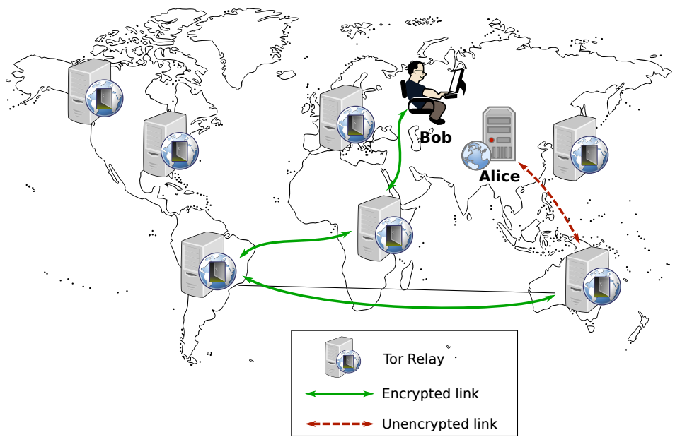

Tor: The 2nd generation onion router
Tor is a volunteer-based low-latency anonymity network
Anonymizes user traffic by forwarding it through a circuit of relays
Each relay in the circuit knows only the immediate transmitter of the message and the immediate receiver of the message
Using Tor makes it more difficult for non-global adversaries to trace Internet activity for TCP applications
Notes:
“If you’re not doing anything wrong, you shouldn’t have anything to hide.”
Do you agree?
Who else uses Tor?
Journalists
Law enforcement
Human rights activists
Normal people
Fact: Tor was/is developed by the Navy

Slide 58

How to use Tor?
Download, install, and execute the Tor client
The client acts as a SOCKS proxy
The client builds and maintains circuits of relays
Configure browser to use the Tor client as a proxy
Any app that supports SOCKS proxies will work with Tor
All traffic from the browser will now be routed through the Tor overlay
Tor circuit establishment uses ideas of onion routing
Notes:
A SOCKS server is a general purpose proxy server that establishes a TCP connection to another server on behalf of a client, then routes all the traffic back and forth between the client and the server. It works for any kind of network protocol on any port. SOCKS Version 5 adds additional support for security and UDP.

Slide 59

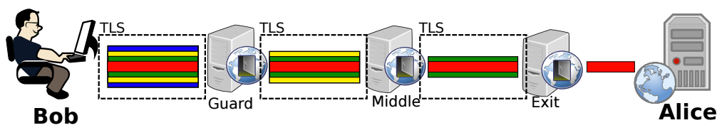

Tor circuit establishment: Relay selection
When Bob wants to connect to Alice through Tor, he downloads the Consensus from the Tor authorities
Nine Tor authorities maintain the list of other Tor relays
List of Tor relays is named Consensus
Bob randomly chooses three Tor relays from the list
Each Tor relay is uniquely identified by an RSA public key
Tor Authorities
Consensus
Notes:
Tor is a semi-decentralized network comprising:
Tor relays which forward client traffic
Nine Tor authorities which maintain the list of other Tor relays and distribute this list to clients
The IP addresses of authorities and their public keys are hard-coded into the Tor code
The list of Tor relays is named Consensus
Each Tor relay is uniquely identified by an RSA public key
The list of all Tor relays is distributed by the Tor authorities in the consensus document
The consensus is updated once an hour by the directory authorities and remains valid for three hours
Every consensus document has a “valid-after” (VA) time, a “fresh-until” (FU) time and a “valid-until” (VU) time
The consensus is considered fresh for one hour (until “fresh-until” has passed) and valid for two hours more (until “valid-until” has passed)

Slide 60
Tor circuit establishment: Connect to 1st relay
A Tor client builds a circuit one hop at a time
Bot sets up a TLS connection with the Entry node
Negotiates a Diffie-Hellman (DH) key with first node in path
TLS connection
Key negotiation with first node (blue)
Entry
Layered encryption

Slide 61
Tor circuit establishment: Connect to 2nd relay
Then complete a DiffieHellman key exchange handshake with the second node by using the first node as a proxy
The middle node does not know the real initiator of the handshake
TLS connection
Key negotiation with second node (yellow)
Entry
Layered encryption

Slide 62
Tor circuit establishment: Connect to 3rd relay
Repeat the same procedure with the third node but use the chain of entry and middle nodes as proxies
TLS connection
Key negotiation with third node (green)
Entry
Layered encryption

Slide 63
Data transmission
To connect to a server on the Internet, the client:
packs his messages in fixed 512-bytes sized cells
encrypts each cells with the three relay keys
Each relay strips off one layer of encryption
Breaks linkability between the sender and the destination
Normally, messages also encrypted using end-to-end protocol
Data transmission (red)
Entry
Layered encryption

Slide 64
Hidden services
Tor is very good at hiding the source of traffic
But the destination is often an exposed website
What if an offender wants to run an anonymous service?
i.e. a website, where nobody knows the IP address?
Tor supports Hidden Services
Allows for running a server and have people connect
… without disclosing the IP or DNS name
Many hidden services
Tor Mail, Tor Char
DuckDuckGo
The Pirate Bay
Silk Road (2.0)
Notes:
https://www.torproject.org/docs/hidden-services.html.en

Slide 65



Hidden service example
Hidden
Service

Slide 66
Hidden service example
Introduction Points
Hidden
Service

Slide 67
Hidden service example
https://go2ndkjdf8whfanf4o.onion
Hidden
Service
Onion URL is a hash, allows any Tor user to find the introduction points
Notes:
https://www.torproject.org/docs/hidden-services.html.en

Slide 68
Hidden service example
https://go2ndkjdf8whfanf4o.onion
Hidden
Service
Rendezvous Point

Slide 69

Hidden service example
Introduce
message
https://go2ndkjdf8whfanf4o.onion
Hidden
Service
Rendezvous Point

Slide 70
Hidden service example
https://go2ndkjdf8whfanf4o.onion
Hidden
Service
Rendezvous Point

Slide 71
Ferramentas do cibercrime
Deep Web
Como encontrar informação e localizer serviços
Ferramentas do Cibercrime
Sistemas de anonimato
Como esconder a ID na Internet
Botnets
Como lançar ataques em larga escala
Criptomoeda
Como tornar os pagamentos não rastreáveis

Slide 72
Botnets

Slide 73
Botnet security threats
Cyber attack sophistication vs. cyber criminal sophistication
bots
Cross site scripting
Tools
“stealth” / advanced scanning techniques
High
Staged attack
packet spoofing
denial of service
Intruder
Knowledge
sniffers
distributed
attack tools
sweepers
www attacks
automated probes/scans
GUI
back doors
disabling audits
network mgmt. diagnostics
hijacking
sessions
burglaries
exploiting known vulnerabilities
Attack
Sophistication
password cracking
self-replicating code
Attackers
Low
password guessing
1980
1985
1990
1995
2000+

Slide 74
What is a botnet?
Botnet: a collection of software “robots” that run on host computers autonomously and automatically, controlled remotely by an attacker or attackers
Truly effective as an online weapon for terrorism
i.e. perform targeted attacks on governments and infrastructure
Primary means for malicious activity:
E.g., launching denial-of-service attacks (DDoS)
Notes:
Stealing personal data such as mail accounts, intellectual property, military secrets, embarrassing information or bank credentials

Slide 75
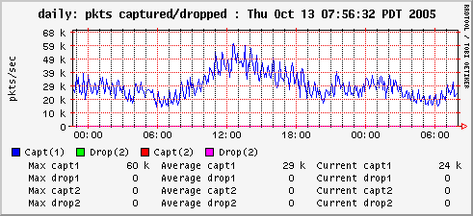
DDoS attacks
Goal: to overwhelm victim machine and deny service to its legitimate clients
Packet graph at a server looks like this normally:

Slide 76
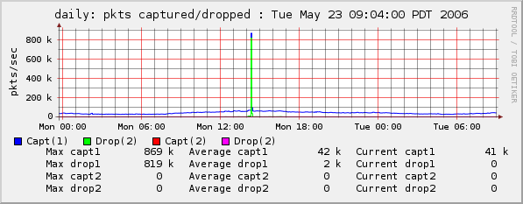
DDoS attacks
Goal: to overwhelm victim machine and deny service to its legitimate clients
Here, we’re under attack: that’s 869K pps

Slide 77

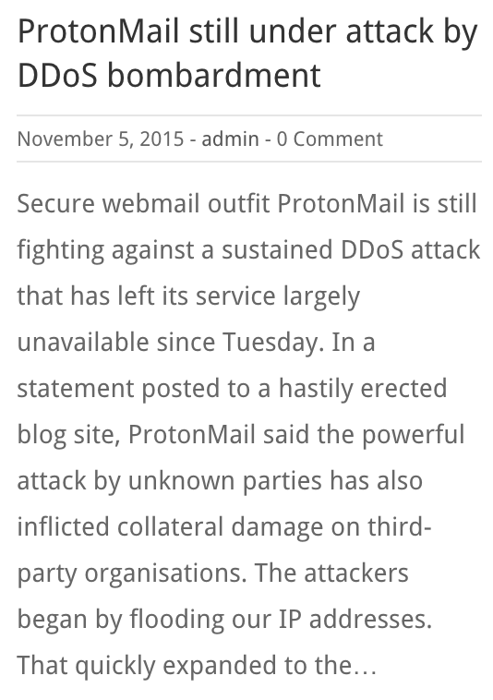
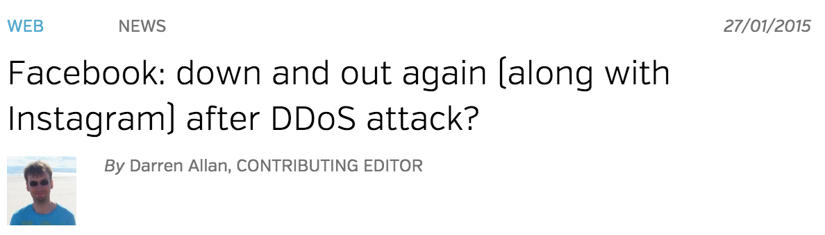
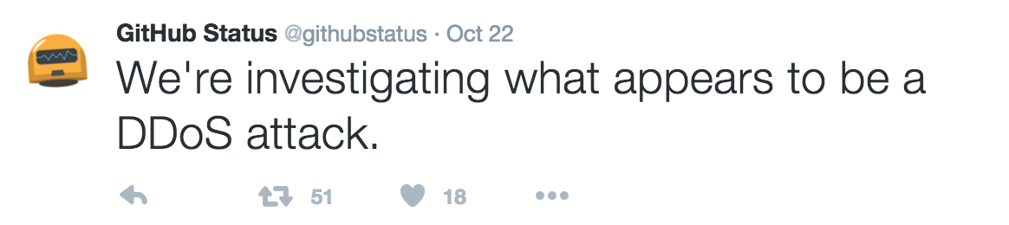
Real world reports of DDoS attacks
From the Twitter blog:

Slide 78


Launching DDoS attacks through a botnet
Attacker
Master machines
Zombie machines
Victim

Slide 79
Botnet activities
DDoS attacks
Data theft
Phishing
Spam
Click fraud
Scan vulnerabilities
…
Notes:
Used by online criminals to make money
Extortion
“Pay use $100K or we will DDoS your website”
Spam and click-fraud
Phishing and theft of personal information
Credit card numbers, bank login information, etc.

Slide 80
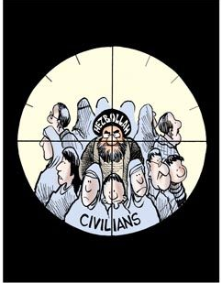
Why are botnets such a powerful tool?
1. Huge scale
2. Hard to defeat
Thousands or millions of zombies
Zombies are part of the crowd
Botnet | Estimated size
Conficker (2008) | 10.500.000
BredoLab (2009) | 30.000.000
Ramnit (2011) | 3.000.000
Torpig | 180.000
Storm | 160.000
Asprox | 15.000
3. Easy to manage

Slide 81
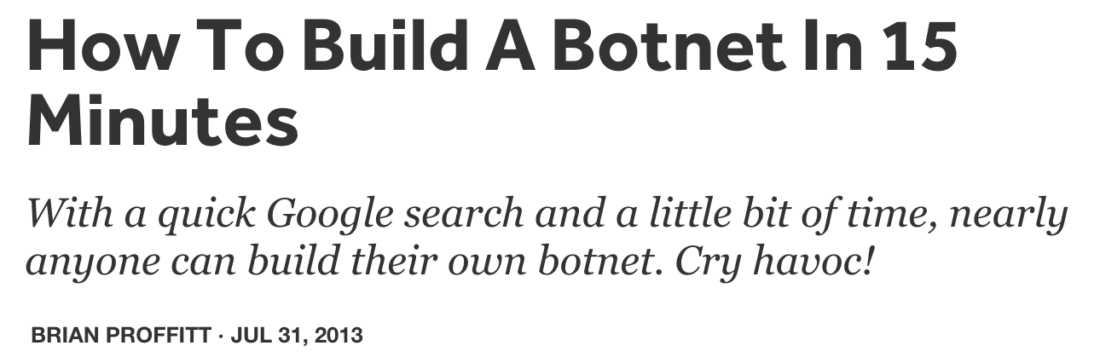
How easy is it to build a botnet?
Botnet kits readily available online for all wallets
Notes:
http://readwrite.com/2013/07/31/how-to-build-a-botnet-in-15-minutes
https://www.fireeye.com/blog/executive-perspective/2013/08/cybercriminal-intent-how-to-build-your-own-botnet-in-less-than-15-minutes.html

Slide 82
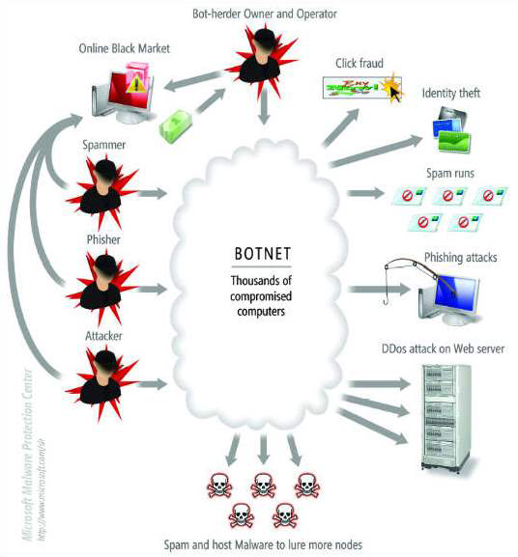
A global botnet market
Botmasters are not necessarily (only) botnet’s end-beneficiaries
Who pays:
Internet Advertising companies for downloading adware onto vulnerable PCs
Companies who send spam, viruses and other malware
…

Slide 83
Botnet recruiting: The big picture
Command and Control (C&C) server
(*) : Optional Step
Notes:
A command-and-control [C&C] server is a computer controlled by an attacker or cybercriminal which is used to send commands to systems compromised by malware and receive stolen data from a target network.
https://www.trendmicro.com/vinfo/us/security/definition/command-and-control-server

Slide 84
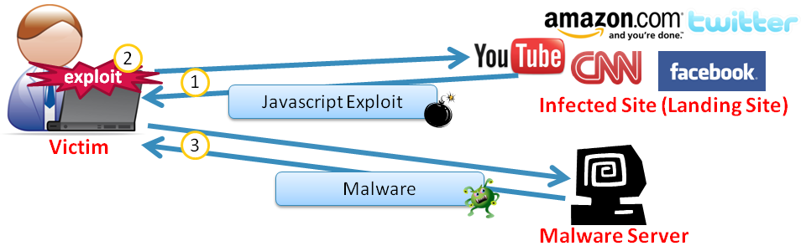
Methods of infecting botnet nodes
Email
Pirated software
Drive-by download
Notes:
Email
A more traditional yet still popular method of botnet infection is through a user opening email with malicious content, often sent by someone the user knows and trusts (whose system is likely infected with a botnet)
Pirated software
Malware developers often hide malicious code inside a software download, which then installs itself on a victim’s machine when the user opens the executable
Drive-by download
Visiting a malicious site with a PC that hasn’t been kept current with security patches and antivirus can download and execute malware on the user’s PC, thus adding to that botnet’s ranks

Slide 85
Trends in botnet design
Botnets tend to be as specific as possible to the task they are assigned to do, e.g.,
spam-only (Conficker) and DDoS-only (Mariposa) botnets
multipurpose botnets, like the Zeus botnet, are decreasing
Large botnets will be aggressive in capturing more computers for their kingdom
SpyEye botnet has an option "Kill Zeus" to disinfect the computer from Zeus malware

Slide 86
Trail obfuscation techniques
Encryption
Botnet malware is encrypted to avoid detection by signature-based IDS
Rootkits
To hide processes, data, or activities on a compromised system
Piggyback on existing protocols and systems
E.g., IRC, HTTP, etc.
Fast Flux and Domain Generation Algorithms (DGA)
To ensure the bot is always able to communicate with its C&C server
P2P botnet architectures
To avoid single point of detection / failure

Slide 87

Centralized C&C architecture
Botmaster
IRC Servers

Slide 88

Centralized C&C architecture: IRC channels
snd spam: <subject> <msg>
Botmaster
snd spam: <subject> <msg>
snd spam: <subject> <msg>
IRC Servers

Slide 89
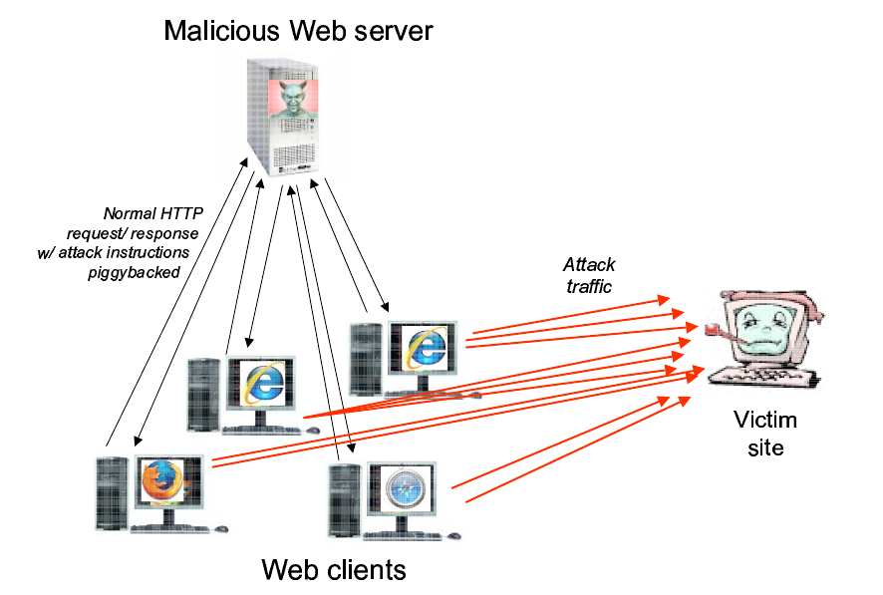
Using HTTP
If HTTP is used, bots query dedicated web sites regularly for getting new commands

Slide 90
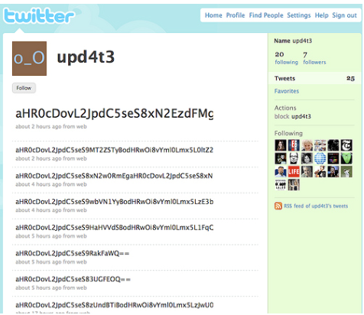
Web services
Social networks becoming the command points for botnets
Botnets targeting industrial systems and mobile devices

Slide 91
Fast flux
Botmaster
HTTP Servers
12.34.56.78
6.4.2.0
31.64.7.22
245.9.1.43
98.102.8.1
www.my-botnet.com
Change DNS→IP mapping every 10 seconds
Notes:
Misconception: since bots connect w/ C&C server, existing tools are able to block the connection
To evade existing methods of blocking access the server, some botnets maintain a list of IPs with which to connect
More advanced botnets use fast flux: IP addresses are rotated against the same domain
Bot master points many IP addresses to the domain names the bot attempts to contact
By changing those records regularly, the bot master ensures they can stay a step ahead of potential actions to shut down the server

Slide 92
Fast flux IP addresses used by a bot
Example of IP addresses that are rotated in seconds against the same domain:
[QUESTION] Website name:
www.lijg.ru
[ANSWER] IP Addresses:
www.lijg.ru → 68.124.161.76
www.lijg.ru → 69.14.27.151
www.lijg.ru → 70.251.45.186
www.lijg.ru → 71.12.89.105
www.lijg.ru → 71.235.251.99
www.lijg.ru → 75.11.10.101
www.lijg.ru → 75.75.104.133
www.lijg.ru → 97.104.40.246
www.lijg.ru → 173.16.99.131
…………………

Slide 93
Thwarting fast flux
Botmaster
HTTP Servers
12.34.56.78
6.4.2.0
31.64.7.22
245.9.1.43
98.102.8.1
But: ISPs can blacklist the rendezvous domain
www.my-botnet.com

Slide 94
Domain Generation Algorithms
DGA: a method in which the malware generates the C&C server address
The malware can determine when to connect to what appears to be a random address online
Bot master ensures random domain name was registered ahead of connection time and created appropriate DNS records to point that address to their C&C server
Examples of random
addresses
eqxowsn.info
ggegtugh.info
hquterpacw.net
oumaac.com
rwyoehbkhdhb.info
rzziyf.info
vmlbhdvtjrn.org
…

Slide 95
Random domain generation
Botmaster
HTTP Servers
www.sb39fwn.com

Slide 96
Random domain generation
Botmaster
HTTP Servers
www.17-cjbq0n.com

Slide 97
Random domain generation
Botmaster
HTTP Servers
www.xx8h4d9n.com

Slide 98
Random domain generation
Bots generate many possible domains each day
Botmaster
…But the Botmaster only needs to register a few
HTTP Servers
www.sb39fwn.com
www.17-cjbq0n.com
www.xx8h4d9n.com
Can be combined with fast flux

Slide 99
P2P Botnets
Structured P2P DHT
Botmaster
Master Servers

Slide 100

P2P Botnets
Structured P2P DHT
Botmaster
Master Servers

Slide 101
P2P Botnets
Insert commands into the DHT
Structured P2P DHT
Botmaster
Master Servers

Slide 102
P2P Botnets
Structured P2P DHT
Botmaster
Master Servers
Get commands from the DHT
Notes:
Resiliencia / latência

Slide 103
Ferramentas do cibercrime
Deep Web
Como encontrar informação e localizer serviços
Ferramentas do Cibercrime
Sistemas de anonimato
Como esconder a ID na Internet
Botnets
Como lançar ataques em larga escala
Criptomoeda
Como tornar os pagamentos não rastreáveis

Slide 104
Conclusions
Botnets are amongst the most advanced tools for carrying out cybercrime (e.g., DDoS, data theft, spam)
To evade detection, botnets employ highly sophisticated techniques, such as P2P architectures, fast flux, DGA, encryption, etc.
Detecting and deterring botnets is a very challenging task and an active topic of security research

Slide 105
Conclusions
Anonymity systems enable general users to preserve their privacy online, but can be used for criminal purposes
Overtime, anonymity systems have evolved so much that that it is hard for forensic investigators to thwart them, notably Tor
Despite the advanced techniques employed by these systems, however, there are weaknesses that allow for user de-anonymization techniques to be successfully employed

Slide 106
Conclusões
Segurança forense desempenha um papel cada vez mais relevante na recolha de prova para resolução de processos judiciais
Deve ser conduzida de forma extremamente rigorosa por forma a preservar a admissibilidade de prova em tribunal
Para adquirir prova digital de sistemas de computadores, é necessário ter muitos factores em conta, por exemplo se se deve desligar o cabo de alimentação ou de rede

